Slide 1
Configuring a Spring MVC Application with Spring Boot

Slide 2

Overview
Configure Spring MVC application
MVC design pattern Useful annotations
Deploy application to Tomcat

Slide 3
<dependency>
<groupId>org.springframework.boot</groupId>
<artifactId>spring-boot-starter-web</artifactId>
</dependency>
Spring MVC Dependency
Dispatcher servlet, error page, servlet container, jars

Slide 4
MVC Design Pattern

Slide 5

MVC Design Pattern
Controller
Activates
Sees
View
Manipulates
User
Displays on
Model

Slide 6
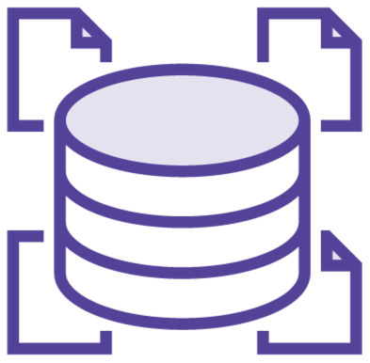
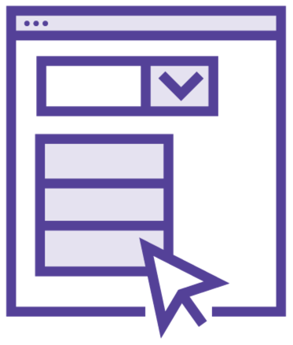

MVC
Model
Representation of data in a system
View
Responsible for displaying data
Controller
Directing incoming user requests

Slide 7
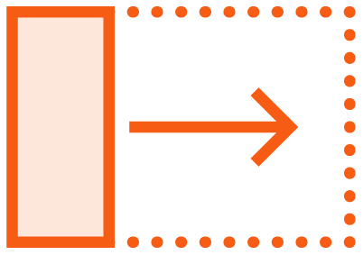


ThymeLeaf
Fragments
Repeatable chunks of code
Components reused across pages

Slide 8
Demo
Model View Controller (MVC) in TrackZilla

Slide 9
Spring Boot Packaging and Deployment

Slide 10
Packaging and Deployment
Packaged as traditional web application in a .war file
Trackzilla is a standalone application
Packaged in an executable JAR file with a main method

Slide 11

Spring
<build>
<plugins>
<plugin>
<groupId>org.springframework.boot</groupId>
<artifactId>spring-boot-maven-plugin</artifactId>
</plugin>
</plugins>
</build>

Slide 12
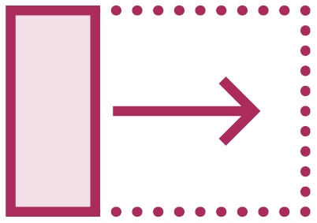



Spring Boot Maven Plugin
Repackages your .jar and .war files to be executable
Runs Spring Boot application
Provides built-in dependency resolver
Manages lifecycle of Spring Boot application

Slide 13

Demo
Application Layers
TzaController
Model
Service
Repository
View

Slide 14
Configure Spring MVC application
Overview of MVC design pattern Useful annotations
Automatic configuration Deploy application to Tomcat
Summary

